Slide 1
Weeks 10 -11: Parsing
W266: Natural Language Processing

Slide 2
Thanksgiving Plans
Nov 18 @ 6pm: James will do an extra Live Session open to all
Nov 19-21 (M-W): As scheduled
Nov 22: No live session
Nov 23: Sid will be teaching his live session.
Nov 24 @ 2pm: Mark will do an extra Live Session open to all
Unfortunately, we aren’t presently allowed to open regularly scheduled live sessions more broadly.

Slide 3
Reminders
A2 feedback
TAs covered the assignment solutions in office hour (recorded)
Individual feedback is released
A3 feedback
TAs covered the assignment solutions in office hour (recorded)
Individual feedback coming
A4
To be released this week

Slide 4
Project Draft Review
Completely optional and ungraded, but...
An opportunity for us to take a first look at a draft of your project report
Aim to do it when you’ve got some block of work completed (baseline models, for example)
Read the project FAQ!
We’ll either provide feedback over email or in an OH.
There will be some latency between giving us your draft and us providing comments, so the earlier the better!

Slide 5
This Week
High Level Goals
Dependency Parsing
Transition-Based Parsing
Graph-Based Parsing

Slide 6
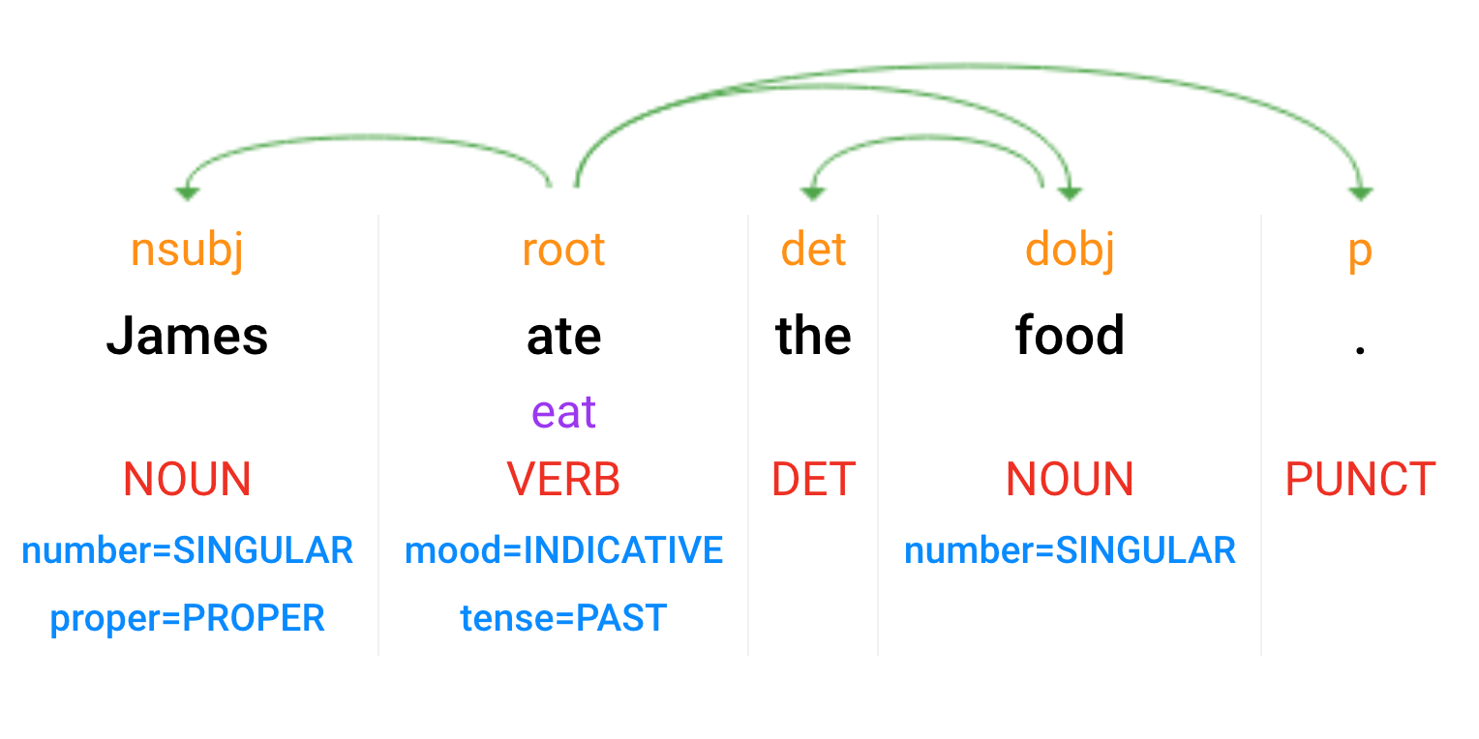
Syntactic Analysis
Parsey McParseface: https://cloud.google.com/natural-language/
Dependency Parse
(+ dependency types)
(Week 10)
Lemmas
Part-of-Speech Tags
(Week 9)
Morphology
Notes:
Scroll down for the test console

Slide 7
Syntactic Analysis
Dependency Parsing (Week 10)

Slide 8
Syntactic Analysis
S
Constituency /
Phrase-Structure Parsing
(Week 11)
VP
NP
NP
NNP
VBD
DT
NN
James
ate
the
food

Slide 9
Parsing: Overview
Parsing: tree-structured prediction
Types of Parsing:
Dependency
Constituency / phrase-structure
(Semantic)
Parsing Techniques / Algorithms:
Transition-based
Graph-based
Chart-based
Similar goal: find the best tree. Different formalisms, but similar algorithms used for all types.
Notes:
Also top-down vs. bottom-up. We’ll mostly consider bottom-up in this class, but top-down algorithms are similar.

Slide 10
Dependency Parsing
Notes:
vs phrase structure grammars & probabilistic CFGs (next week)

Slide 11
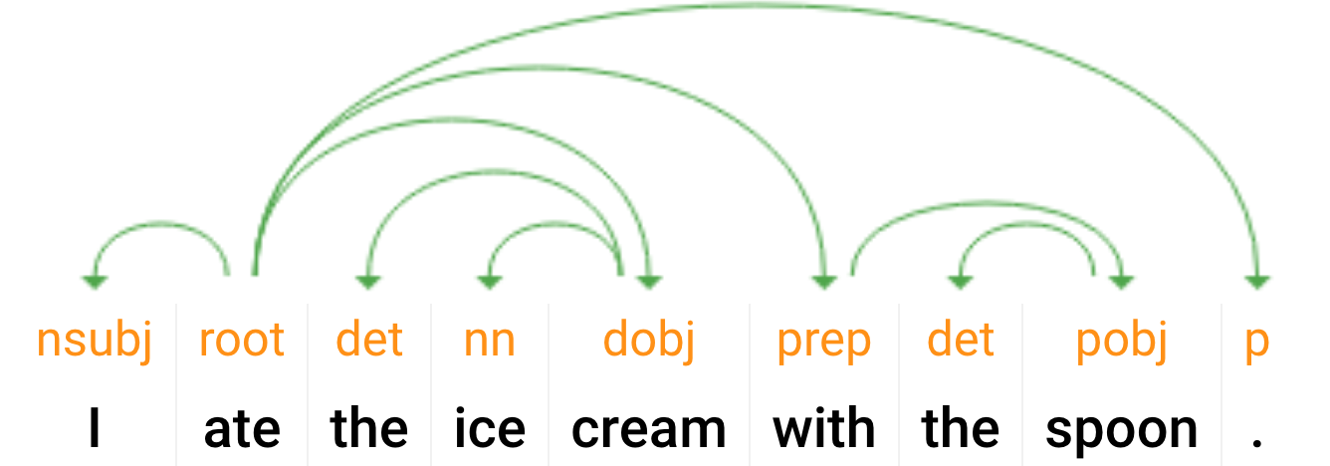
Parsing!
What’s the goal?
I ate the ice_cream with the spoon.
I ate the ice_cream with the cherry.
Notes:
“Pasta: With chopsticks vs. with sauce” in async

Slide 12
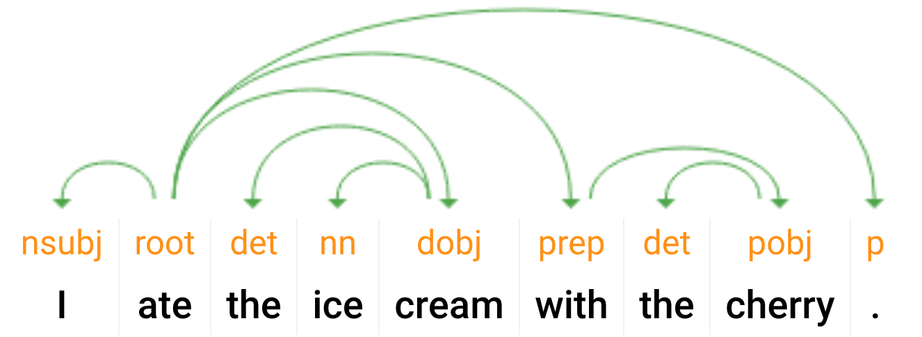
Parsing!
What’s the goal?
I ate the ice_cream with the spoon.
I ate the ice_cream with the cherry.
Notes:
“Pasta: With chopsticks vs. with sauce” in async

Slide 13
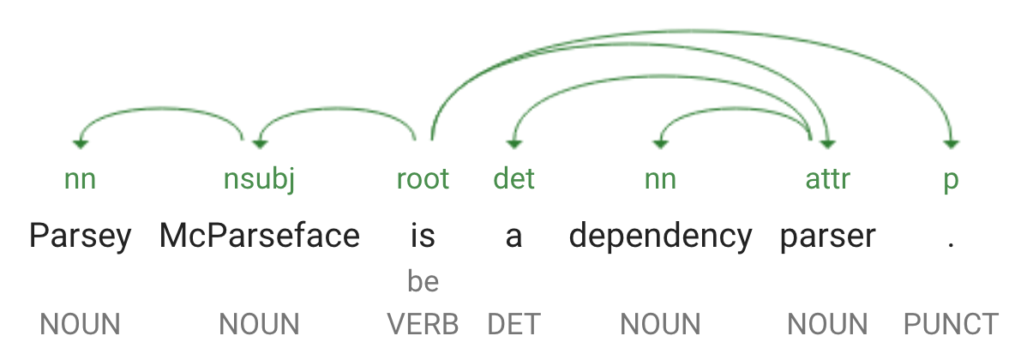
Parsing!
Not a single formalism / correct answer
Universal Dependencies tries for this
Methods work regardless: just need training data
In all of the methods we discuss:
“How do I build the parse tree?”

Slide 14
Formal definition of Dependency Parsing
Formally, a dependency structure for a given sentence is a directed graph originating out of a unique and artificially inserted root node.
In the most common case, every valid dependency graph has the following properties,
It is weakly connected (in the directed sense).
Each word has exactly one incoming edge in the graph (except the root, which has no incoming edge).
There are no cycles.

Slide 15
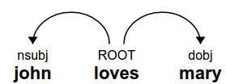
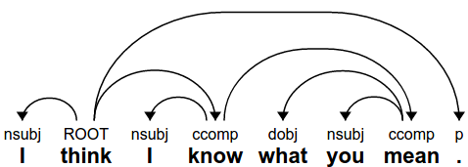
Examples of dependency trees
Each word has an incoming edge - except ROOT (not drawn)
The graphs are connected
There are function labels (which we sometimes leave out)
Notes:
ROOT (loves) ->(nsubj) john
->(dobj) mary

Slide 16
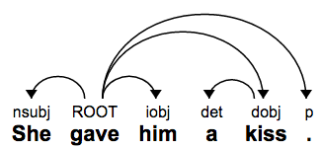
Some linguistic phenomena you can capture
Who did what to whom:
Subject, direct object, indirect object

Slide 17
Some linguistic phenomena you can capture
Who did what to whom:
Subject, direct object, indirect object

Slide 18
Some linguistic phenomena you can capture
Who did what to whom:
Subject, direct object, indirect object

Slide 19
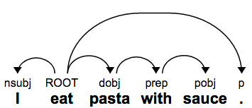
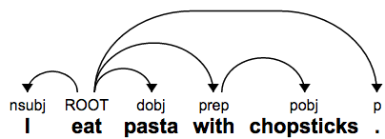
Prepositional phrase attachment
Eat → with → chopsticks vs pasta → with → sauce

Slide 20
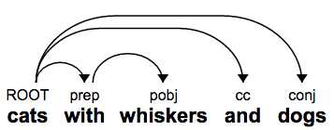
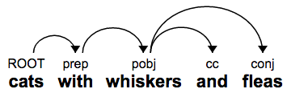
Coordination
In one case, we have cats and dogs, where the cats have whiskers
In the other, we have cats who have both whiskers and fleas
Notes:
More examples and definitions - https://nlp.stanford.edu/software/dependencies_manual.pdf

Slide 21
Transition-Based Parsing

Slide 22
SyntaxNet / Parsey McParseface
Animation from Google Research Blog

Slide 23
Transition based parsing
Mechanism: build parse tree by sequence of actions (transitions)
Set-up (state):
A buffer initialized with the words
A stack to store state:
Words under consideration for more edges
Dependency arcs (edges)
The partially-constructed tree
ROOT
John
loves
Mary
.
Stack
Buffer
Notes:
Related to algorithms for parsing deterministic grammars such as programming languages (e.g. LALR parsers). More generally, any context-free grammar (we’ll discuss next week) can be parsed using a transition system.

Slide 24
Transition based parsing
Mechanism: build parse tree by sequence of actions (transitions)
Arc-Standard parsing:
Shift: pop from buffer, push to stack
Left-arc: add left edge
Right-arc: add right edge
ROOT
John
loves
Mary
.
Stack
Buffer

Slide 25
Arc-Standard Parsing Example
Arc-Standard parsing:
Shift: pop from buffer, push to stack
Left-arc: add left edge
Right-arc: add right edge
ROOT
John
loves
Mary
.
Stack
Buffer

Slide 26
Arc-Standard Parsing Example
Arc-Standard parsing:
Shift: pop from buffer, push to stack
Left-arc: add left edge
Right-arc: add right edge
ROOT
John
loves
Mary
.
Stack
Buffer

Slide 27
Arc-Standard Parsing Example
Arc-Standard parsing:
Shift: pop from buffer, push to stack
Left-arc: add left edge
Right-arc: add right edge
ROOT
John
loves
Mary
.
Stack
Buffer

Slide 28
Arc-Standard Parsing Example
Arc-Standard parsing:
Shift: pop from buffer, push to stack
Left-arc: add left edge
Right-arc: add right edge
Remove child from stack
ROOT
John
loves
Mary
.
Stack
Buffer

Slide 29
Arc-Standard Parsing Example
Arc-Standard parsing:
Shift: pop from buffer, push to stack
Left-arc: add left edge
Right-arc: add right edge
Remove child from stack
ROOT
John
loves
.
Mary
Stack
Buffer

Slide 30
Arc-Standard Parsing Example
Arc-Standard parsing:
Shift: pop from buffer, push to stack
Left-arc: add left edge
Remove child from stack
Right-arc: add right edge
nsubj
dobj
ROOT
John
loves
.
Mary
Stack
Buffer

Slide 31
Arc-Standard Parsing Example
Arc-Standard parsing:
Shift: pop from buffer, push to stack
Left-arc: add left edge
Remove child from stack
Right-arc: add right edge
ROOT
loves
.
John
Mary
Stack
Buffer

Slide 32
Arc-Standard Parsing Example
Arc-Standard parsing:
Shift: pop from buffer, push to stack
Left-arc: add left edge
Right-arc: add right edge
ROOT
loves
.
John
Mary
Stack
Buffer

Slide 33
Arc-Standard Parsing Example
Arc-Standard parsing:
Shift: pop from buffer, push to stack
Left-arc: add left edge
Right-arc: add right edge
Remove child from stack
ROOT
loves
.
John
Mary
Stack
Buffer

Slide 34
Arc-Standard Parsing Example
Arc-Standard parsing:
Shift: pop from buffer, push to stack
Left-arc: add left edge
Right-arc: add right edge
Remove child from stack
ROOT
loves
John
Mary
.
Stack
Buffer

Slide 35
Arc-Standard Parsing Example
Arc-Standard parsing:
Shift: pop from buffer, push to stack
Left-arc: add left edge
Right-arc: add right edge
Remove child from stack
ROOT
loves
Stack
Buffer
John
Mary
.

Slide 36
Arc-Standard Parsing Example
Arc-Standard parsing:
Shift: pop from buffer, push to stack
Left-arc: add left edge
Right-arc: add right edge
ROOT
John
loves
Mary
.
Notes:
Read off parse tree from edges.

Slide 37
Transition-Based Parsing: Analysis
“Shift-reduce” parsing:
Shift: (shift) move from buffer to stack
Reduce: (left-arc, right-arc) add edges, and remove elements from stack
For N tokens:
O(N) shift operations (one for each token)
O(N) reduce operations (one for each edge)
O(N) = linear time parsing! (if you can choose the right transitions)

Slide 38
Arc-Standard vs. Arc-Eager
Arc-Standard:
Shift:
Pop buffer[0], push onto stack
Left-arc:
Add edge stack[-2] ← stack[-1]
Remove stack[-2] from stack
Right-arc:
Add edge stack[-2] → stack[-1]
Remove stack[-1] from stack
Guaranteed to produce a single tree
Arc-Eager:
Shift:
Pop buffer[0], push onto stack
Left-arc:
Add edge stack[-1] ← buffer[0]
Remove stack[-1] from stack
Right-arc:
Add edge stack[-1] → buffer[0]
Pop buffer[0], push onto stack
Reduce:
Remove stack[-1] from stack
Can produce forest (multiple trees)
Some sequences yield the same tree / forest (spurious ambiguity)

Slide 39
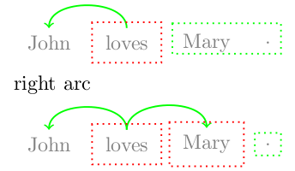
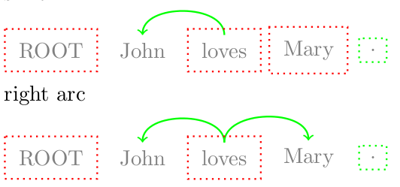
Transition based parsing: Arc Eager
Very similar, but across stack & buffer instead of top two in stack.
“Right” has changed: it moves its target into the stack, rather than removing it altogether. Allows the child to accrue children itself.
Arc Eager
Arc Standard
Notes:
Allow top down instead of just bottom up

Slide 40
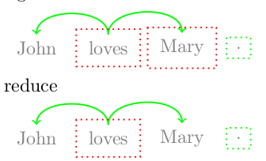
Transition based parsing: Arc Eager
Addition of a “Reduce” transition, to continue to allow equivalent of Arc-Standard

Slide 41
Transition-Based Parsing: Analysis
“Shift-reduce” parsing:
Shift: (shift) move from buffer to stack
Reduce: (left-arc, right-arc) add edges, and remove elements from stack
Actions are irreversible! Cannot undo with other transitions.
Corollary: must choose correct* action every time!
* May be more than one correct action! (spurious ambiguity)
How do you choose the right one?

Slide 42
Training?
Training data
A large number of sentences with edges between their words
Fundamental question:
How to apply machine learning?
Answer: An Oracle!
Notes:
But wait, what if multi-path? Dynamic oracle.

Slide 43
How to choose transitions?
Multi-class prediction:
Inputs: state = {stack, buffer, other features}
Targets: transitions = {shift, left-arc, right-arc}
Classifier: score(a_{i} | state_{i}) at step i
Rule-based, SVM, NN, etc.
Training:
Predict “gold” actions (from true tree)
Or: “dynamic oracle” rewards good actions
score(Shift)
score(Left-Arc)
score(Right-Arc)
h2
h1
Stack features
Buffer features
ROOT
John
loves
Mary
.
Stack
Buffer

Slide 44
Inference: protecting against mistakes
Performing inference is easy:
Initialize the stack & buffer
Apply model to determine best next transition, apply it, repeat!
What is “best”?
What if two are “close”?
Commit entirely to one?

Slide 45
Inference: Beam Search
Choosing transitions as a search problem: what is the best path to my goal?
Goal: complete parse tree
Path: sequence of actions (transitions) {a₀,a₁,a₂,...}
“Best”: highest scoring (according to model score = 𝚺_{i} score(a_{i}) )
Greedy: pick highest scoring transition at each step
Beam search: keep “beam” of k top-scoring candidates (up to complete trees)
Can do this during training as well!
Notes:
In general, not possible to do exact inference for transition systems (too many possibilities). But, beam search works very well. Next week, we’ll look at the CKY algorithm, which uses DP for exact inference in parsing.

Slide 46
Inference: Beam Search
Shift
-1.7
Beam search: keep “beam” of k top-scoring candidates (up to complete trees)
Similar to Viterbi, but can’t make Markov assumption
Solution: keep top k histories
Generate (k x num_actions) candidates
Sort and prune to top k
Shift
Left-Arc
-5.2
Right-Arc
-4.0
Shift
-2.6
Left-Arc
Left-Arc
-8.7
Right-Arc
-4.5
Shift
-3.4
Right-Arc
Left-Arc
-3.1
Right-Arc
-10.0
Step 0 beam
Step 1 candidates

Slide 47
Inference: Beam Search
Shift
-1.7
Beam search: keep “beam” of k top-scoring candidates (up to complete trees)
Similar to Viterbi, but can’t make Markov assumption
Solution: keep top k histories
Generate (k x num_actions) candidates
Sort and prune to top k
Shift
Shift
-2.6
Left-Arc
-3.1
Shift
-3.4
Left-Arc
Right-Arc
-4.0
Right-Arc
-4.5
Left-Arc
-5.2
Right-Arc
Left-Arc
-8.7
Right-Arc
-10.0
Step 0 beam
Step 1 candidates

Slide 48
Inference: Beam Search
k = 5
Shift
Beam search: keep “beam” of k top-scoring candidates (up to complete trees)
Similar to Viterbi, but can’t make Markov assumption
Solution: keep top k histories
Generate (k x num_actions) candidates
Sort and prune to top k
Shift
Shift
Left-Arc
Shift
Left-Arc
Right-Arc
Right-Arc
Left-Arc
Right-Arc
Left-Arc
Right-Arc
Step 0 beam
Step 1 candidates

Slide 49
Inference: Beam Search
Beam search: keep “beam” of k top-scoring candidates (up to complete trees)
Similar to Viterbi, but can’t make Markov assumption
Solution: keep top k histories
Generate (k x num_actions) candidates
Sort and prune to top k
Shift
Shift
Shift
Left-Arc
Left-Arc
Shift
Right-Arc
Right-Arc
Step 0 beam
Step 1 beam

Slide 50
Inference: Beam Search
Shift
Shift
Shift
Left-Arc
Right-Arc
Shift
Shift
Left-Arc
Left-Arc
Left-Arc
Right-Arc
Shift
Shift
Right-Arc
Right-Arc
...
...
Step 0 beam
Step 1 beam
Step 2 candidates

Slide 51
Graph-Based Parsing

Slide 52
Chu-Liu-Edmonds
Goal… the same!
Handle non-projective sentences (e.g. 23 Cz, 20.3 Gr)
(From: Multilingual Natural Language Processing Applications: From Theory to Practice)
Approach:
Simple: each node picks the incoming edge with the best score
Don’t need to worry about if it’s a projective tree…
If you get a tree, declare yourself done!
Otherwise: collapse cycles and break them
This is a general algorithm for finding Directed Max-Spanning Tree (DMST).
Notes:
languagelog.ldc.upenn.edu/nll/?p=7851
Why is "You can't put flavor into a bean that isn't already there" non-projective? Well, the prepositional phrase "into a bean" is part of the complement of the verb "put", while the relative clause "that isn't already there" modifies the noun "flavor". So the arc connecting "put" to "in" will cross the arc connecting "flavor" to the relative clause.

Slide 53
Graph based parsing
Goal remains the same
Allows arbitrary graphs between words, not just “projective trees”
There are two prominent algorithms:
Eisner
Chu-Liu-Edmonds

Slide 54
Week 11: Constituency and Chart-Based Parsing

Slide 55
Syntactic Analysis
S
Constituency /
Phrase-Structure Parsing
(Week 11)
VP
NP
NP
NNP
VBD
DT
NN
James
ate
the
food

Slide 56
Parsing: Overview
Parsing: tree-structured prediction
Types of Parsing:
Dependency
Constituency / phrase-structure
(Semantic)
Parsing Techniques / Algorithms:
Transition-based
Graph-based
Chart-based
Similar goal: find the best tree. Different formalisms, but similar algorithms used for all types.
Notes:
Also top-down vs. bottom-up. We’ll mostly consider bottom-up in this class, but top-down algorithms are similar.

Slide 57
Context-Free Grammars
Grammar rules: A → B C, A → “a”
Apply by recursive expansion of symbols (nonterminals)
S → NP VP
NP → NNP
VP → VBD NP
NP → DT NN
NNP → “James”
VBD → “ate”
DT → “the”
NN → “food”
S
VP
NP
NP
NNP
VBD
DT
NN
James
ate
the
food

Slide 58
Context-Free Grammars
Symbol types:
Nonterminals (constituents), Preterminals (POS tags), Terminals (types)
S → NP VP
NP → NNP
VP → VBD NP
NP → DT NN
NNP → “James”
VBD → “ate”
DT → “the”
NN → “food”
S
VP
NP
NP
NNP
VBD
DT
NN
James
ate
the
food

Slide 59
Chart-Based Parsing
The Chart: dynamic programming table
n(n+1)/2 cells
Represent spans [i,j)
Entries: subtree derivations
Example:
(ROOT (S (NP (NNP James)) (VP (VBD ate) (NP (DT the) (NN food)))))
S
VP
NP
NP/NNP
VBD
DT
NN
James
ate
the
food
Notes:
(1 + 2 + 3 + …. + n) = n(n+1)/2

Slide 60
Chart-Based Parsing
The Chart: dynamic programming table
n(n+1)/2 cells
Represent spans [i,j)
Entries: subtree derivations
(for each symbol)
Top cell: full derivation
CKY Algorithm:
Extension of Viterbi decoding
Assume binary tree and grammar
For each cell, consider L, R subtrees
Choose best candidate
Store backpointers
S
VP
NP
NP/NNP
VBD
DT
NN
James
ate
the
food

Slide 61
Chart-Based Parsing
CKY Algorithm:
Token cells: [i, i+1) (assume have POS tags)
Store best score(i,j,X) for symbol X
For each cell [i,j), bottom-up:
For each rule (A → B C):
For each split i ﹤ ℓ ≤ j:
x = score(i,ℓ,B) + score(ℓ,j,C)
+ weight(A → B C)
If x > score(i,j,A):
score(i,j,A) = x
children(i,j,A) = [(i,ℓ,B),
(ℓ,j,C)]
S
VP
NP
NP/NNP
VBD
DT
NN
James
ate
the
food
Notes:
Note NP/NNP: there’s an unary rule NP -> NNP that we have to apply in-cell.

Slide 62
CKY Algorithm
S → NP VP
NP → NNP
VP → VBD NP
NP → DT NN
NNP → “James”
VBD → “ate”
DT → “the”
NN → “food”
Token cells: [i, i+1) (assume have POS tags)
Store best score(i,j,X) for symbol X
For each cell [i,j), bottom-up:
For each rule (A → B C):
For each split i ﹤ ℓ ≤ j:
x = score(i,ℓ,B) + score(ℓ,j,C)
+ weight(A → B C)
If x > score(i,j,A):
score(i,j,A) = x
children(i,j,A) = [(i,ℓ,B),
(ℓ,j,C)]
?
?
?
?
James
ate
the
food
0
1
2
3
4

Slide 63
CKY Algorithm
S → NP VP
NP → NNP
VP → VBD NP
NP → DT NN
NNP → “James”
VBD → “ate”
DT → “the”
NN → “food”
Token cells: [i, i+1) (assume have POS tags)
Store best score(i,j,X) for symbol X
For each cell [i,j), bottom-up:
For each rule (A → B C):
For each split i ﹤ ℓ ≤ j:
x = score(i,ℓ,B) + score(ℓ,j,C)
+ weight(A → B C)
If x > score(i,j,A):
score(i,j,A) = x
children(i,j,A) = [(i,ℓ,B),
(ℓ,j,C)]
NNP
VBD
DT
NN
James
ate
the
food
0
1
2
3
4

Slide 64
CKY Algorithm
S → NP VP
NP → NNP
VP → VBD NP
NP → DT NN
NNP → “James”
VBD → “ate”
DT → “the”
NN → “food”
Token cells: [i, i+1) (assume have POS tags)
Store best score(i,j,X) for symbol X
For each cell [i,j), bottom-up:
For each rule (A → B C):
For each split i ﹤ ℓ ≤ j:
x = score(i,ℓ,B) + score(ℓ,j,C)
+ weight(A → B C)
If x > score(i,j,A):
score(i,j,A) = x
children(i,j,A) = [(i,ℓ,B),
(ℓ,j,C)]
NP/NNP
VBD
DT
NN
James
ate
the
food
0
1
2
3
4

Slide 65
CKY Algorithm
S → NP VP
NP → “James”
VP → VBD NP
NP → DT NN
VBD → “ate”
DT → “the”
NN → “food”
Token cells: [i, i+1) (assume have POS tags)
Store best score(i,j,X) for symbol X
For each cell [i,j), bottom-up:
For each rule (A → B C):
For each split i ﹤ ℓ ≤ j:
x = score(i,ℓ,B) + score(ℓ,j,C)
+ weight(A → B C)
If x > score(i,j,A):
score(i,j,A) = x
children(i,j,A) = [(i,ℓ,B),
(ℓ,j,C)]
NP
VBD
DT
NN
James
ate
the
food
0
1
2
3
4

Slide 66
CKY Algorithm
S → NP VP
NP → NNP
VP → VBD NP
NP → DT NN
NNP → “James”
VBD → “ate”
DT → “the”
NN → “food”
Token cells: [i, i+1) (assume have POS tags)
Store best score(i,j,X) for symbol X
For each cell [i,j), bottom-up:
For each rule (A → B C):
For each split i ﹤ ℓ ≤ j:
x = score(i,ℓ,B) + score(ℓ,j,C)
+ weight(A → B C)
If x > score(i,j,A):
score(i,j,A) = x
children(i,j,A) = [(i,ℓ,B),
(ℓ,j,C)]
?
NP/NNP
VBD
DT
NN
James
ate
the
food
0
1
2
3
4

Slide 67
CKY Algorithm
S → NP VP
NP → NNP
VP → VBD NP
NP → DT NN
NNP → “James”
VBD → “ate”
DT → “the”
NN → “food”
Token cells: [i, i+1) (assume have POS tags)
Store best score(i,j,X) for symbol X
For each cell [i,j), bottom-up:
For each rule (A → B C):
For each split i ﹤ ℓ ≤ j:
x = score(i,ℓ,B) + score(ℓ,j,C)
+ weight(A → B C)
If x > score(i,j,A):
score(i,j,A) = x
children(i,j,A) = [(i,ℓ,B),
(ℓ,j,C)]
NP
NP/NNP
VBD
DT
NN
James
ate
the
food
0
1
2
3
4

Slide 68
CKY Algorithm
S → NP VP
NP → NNP
VP → VBD NP
NP → DT NN
NNP → “James”
VBD → “ate”
DT → “the”
NN → “food”
Token cells: [i, i+1) (assume have POS tags)
Store best score(i,j,X) for symbol X
For each cell [i,j), bottom-up:
For each rule (A → B C):
For each split i ﹤ ℓ ≤ j:
x = score(i,ℓ,B) + score(ℓ,j,C)
+ weight(A → B C)
If x > score(i,j,A):
score(i,j,A) = x
children(i,j,A) = [(i,ℓ,B),
(ℓ,j,C)]
?
NP
NP/NNP
VBD
DT
NN
James
ate
the
food
0
1
2
3
4

Slide 69
CKY Algorithm
S → NP VP
NP → NNP
VP → VBD NP
NP → DT NN
NNP → “James”
VBD → “ate”
DT → “the”
NN → “food”
Token cells: [i, i+1) (assume have POS tags)
Store best score(i,j,X) for symbol X
For each cell [i,j), bottom-up:
For each rule (A → B C):
For each split i ﹤ ℓ ≤ j:
x = score(i,ℓ,B) + score(ℓ,j,C)
+ weight(A → B C)
If x > score(i,j,A):
score(i,j,A) = x
children(i,j,A) = [(i,ℓ,B),
(ℓ,j,C)]
?
NP
NP/NNP
VBD
DT
NN
James
ate
the
food
0
1
2
3
4

Slide 70
CKY Algorithm
S → NP VP
NP → NNP
VP → VBD NP
NP → DT NN
NNP → “James”
VBD → “ate”
DT → “the”
NN → “food”
Token cells: [i, i+1) (assume have POS tags)
Store best score(i,j,X) for symbol X
For each cell [i,j), bottom-up:
For each rule (A → B C):
For each split i ﹤ ℓ ≤ j:
x = score(i,ℓ,B) + score(ℓ,j,C)
+ weight(A → B C)
If x > score(i,j,A):
score(i,j,A) = x
children(i,j,A) = [(i,ℓ,B),
(ℓ,j,C)]
VP
NP
NP/NNP
VBD
DT
NN
James
ate
the
food
0
1
2
3
4
Notes:
chart[(1,4)]
Split = 2
Look at chart[(1,2)] and chart[(2,4)]
In chart[(1,2)][VBD] -> tree_B = ProbabilisticTree(VBD, [“ate”], logprob=...)
In chart[(2,4)][NP] -> tree_C = ProbabilisticTree(NP, [ProbabilisticTree(DT, [“the”], …), ProbabilisticTree(NN, [“food”], …), …)
A = VP ?
…
A = NP ?
If new_score > chart[(i,j)][A].logprob(): # replace with new, better derivation (tree_A)
chart[(i,j)][A] = ProbabilisticTree(A, [tree_B, tree_C], logprob=new_score)

Slide 71
CKY Algorithm
S → NP VP
NP → NNP
VP → VBD NP
NP → DT NN
NNP → “James”
VBD → “ate”
DT → “the”
NN → “food”
Token cells: [i, i+1) (assume have POS tags)
Store best score(i,j,X) for symbol X
For each cell [i,j), bottom-up:
For each rule (A → B C):
For each split i ﹤ ℓ ≤ j:
x = score(i,ℓ,B) + score(ℓ,j,C)
+ weight(A → B C)
If x > score(i,j,A):
score(i,j,A) = x
children(i,j,A) = [(i,ℓ,B),
(ℓ,j,C)]
?
NP
NP/NNP
VBD
DT
NN
James
ate
the
food
0
1
2
3
4

Slide 72
CKY Algorithm
S → NP VP
NP → NNP
VP → VBD NP
NP → DT NN
NNP → “James”
VBD → “ate”
DT → “the”
NN → “food”
Token cells: [i, i+1) (assume have POS tags)
Store best score(i,j,X) for symbol X
For each cell [i,j), bottom-up:
For each rule (A → B C):
For each split i ﹤ ℓ ≤ j:
x = score(i,ℓ,B) + score(ℓ,j,C)
+ weight(A → B C)
If x > score(i,j,A):
score(i,j,A) = x
children(i,j,A) = [(i,ℓ,B),
(ℓ,j,C)]
S
VP
NP
NP/NNP
VBD
DT
NN
James
ate
the
food
0
1
2
3
4

Slide 73
CKY Algorithm
Token cells: [i, i+1) (assume have POS tags)
Store best score(i,j,X) for symbol X
For each cell [i,j), bottom-up: O(n^2)
For each rule (A → B C): O(k^3)
For each split i ﹤ ℓ ≤ j: O(n)
x = score(i,ℓ,B) + score(ℓ,j,C)
+ weight(A → B C)
If x > score(i,j,A):
score(i,j,A) = x
children(i,j,A) = [(i,ℓ,B),
(ℓ,j,C)]
S
VP
NP
NP/NNP
VBD
DT
NN
James
ate
the
food
0
1
2
3
4

Slide 74
Two important considerations...
Ambiguity: what is “score”?
c(A -> B C)
weight(A -> B C) = log(p(A -> B C)) = log( c(A -> B C) / c(A) )
Chomsky Normal Form (CNF)
S
VP
NP
NP
NNP
VBD
DT
NN
James
ate
the
food

Slide 75
“Score”: Probabilistic Context-Free Grammars
Grammar rules: A → B C, A → “a”
Each rule has a probability associated with the production
Normalized by the left hand side
S → NP VP [1.0]
NP → NNP [0.6]
NP → DT NN [0.4]
VP → VBD NP [1.0]
NNP → “James” [...]
VBD → “ate”
DT → “the”
NN → “food”
S
VP
NP
NP
NNP
VBD
DT
NN
James
ate
the
food

Slide 76
Relationship to Viterbi and Pipe Cutting
Token cells: [i, i+1) (assume have POS tags)
Store best score(i,j,X) for symbol X
For each cell [i,j), bottom-up:
For each rule (A → B C):
For each split i ﹤ ℓ ≤ j:
x = score(i,ℓ,B) + score(ℓ,j,C) similar to
+ weight(A → B C) best_cuts_with_trace!
If x > score(i,j,A):
score(i,j,A) = x “max”
children(i,j,A) = [(i,ℓ,B),
(ℓ,j,C)]

Slide 77
Chomsky Normal Form
Grammar rules:
A → B C
A → “a”
(or, S → epsilon)
Not allowed:
A → B C D
No problem:
A → B E
E → C D (often the name “C|D” is used instead of “E”)

Slide 78
Chomsky Normal Form
Grammar rules:
A → B C
A → “a”
(or, S → epsilon)
Not allowed:
A → B
B → C
No problem:
A → B
A → C

Slide 79
Chomsky Normal Form
Grammar rules:
A → B C
A → “a”
(or, S → epsilon)
Convenience function in nltk to convert a grammar to CNF.

